Slide 1
Introduction to Electric and Electronics
Chapter 9 –
Diode, Semiconductors
and Applications

Slide 2
Learning Objectives
Learning Objectives
To learn what a diode is and its basic characteristics
To understand properties of a semiconductor and how a p-n junction diode works
To learn how to analyze circuits containing diodes

Slide 3
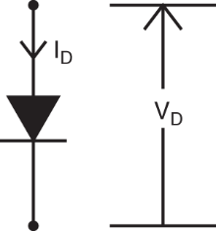
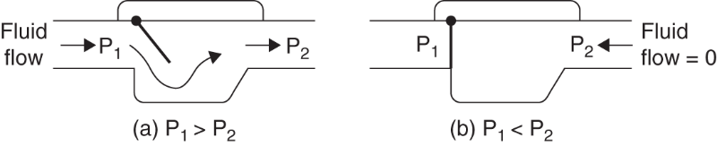
The Diode and its basic characteristics
The Diode and its basic characteristics
Diode
two-terminal electronic device
forward bias; conducts current
reverse bias; refuses to conduct current
“check “ valves or “flapper” valves

Slide 4
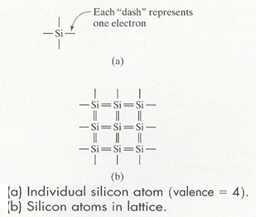
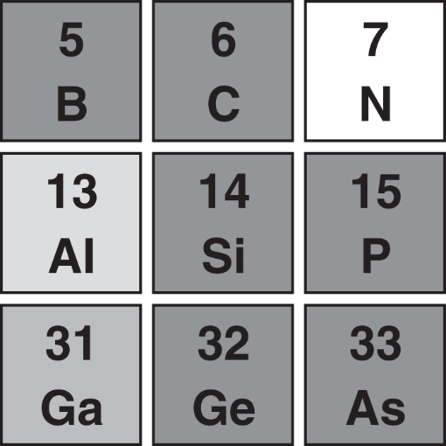
Introduction to Semiconductors
Introduction to Semiconductors
Elements surrounding silicon in periodic table
group four elements
covalent bonds
form crystal lattice → poor conductor

Slide 5
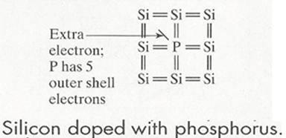
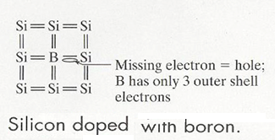
Introduction to Semiconductors
Dopping
intrinsic ; pure silicon
dopants ; impurities
n-Type silicon
donor
Phosphorus
free electron
p-Type silicon
acceptor
Boron
hole

Slide 6
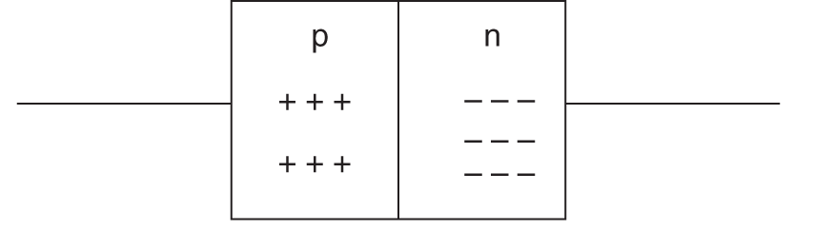
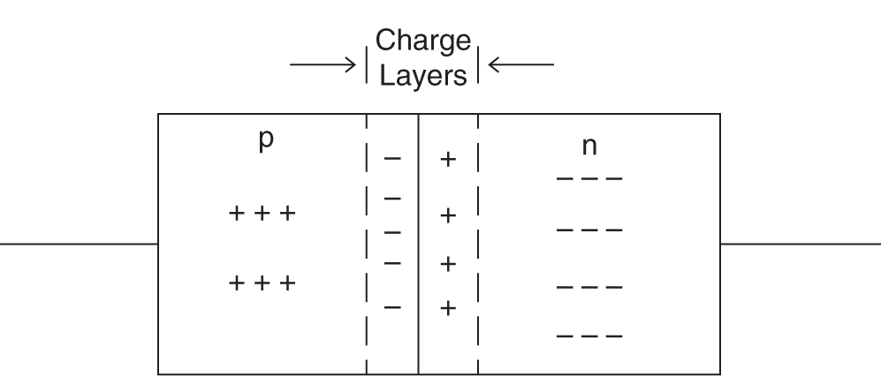
How a p-n junction diode works
How a p-n junction diode works
p-n junction
depletion region

Slide 7
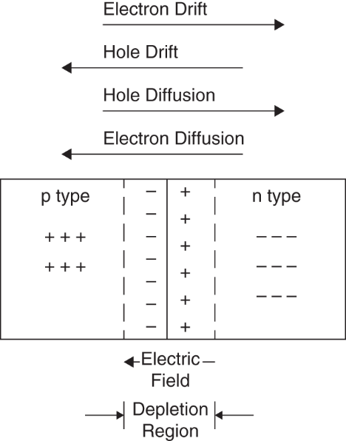
How a p-n junction diode works
Drift and diffusion currents in a p-n junction

Slide 8
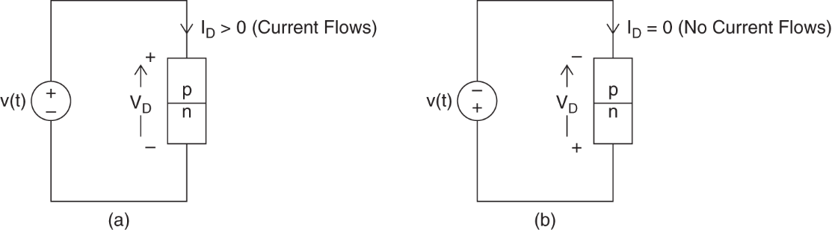
How a p-n junction diode works
Forward- and reverse-biased p-n junctions

Slide 9
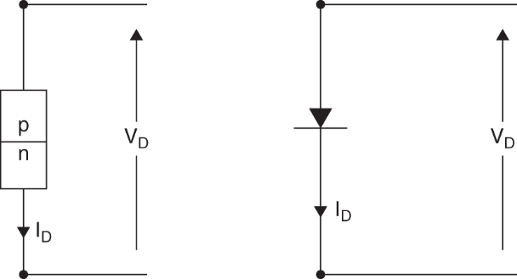
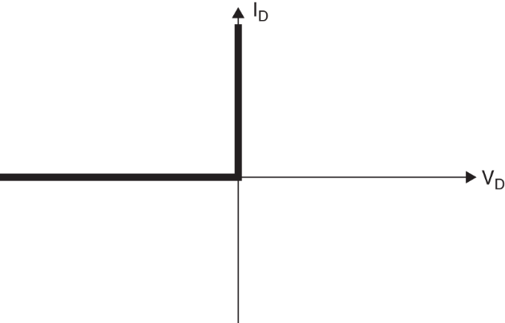
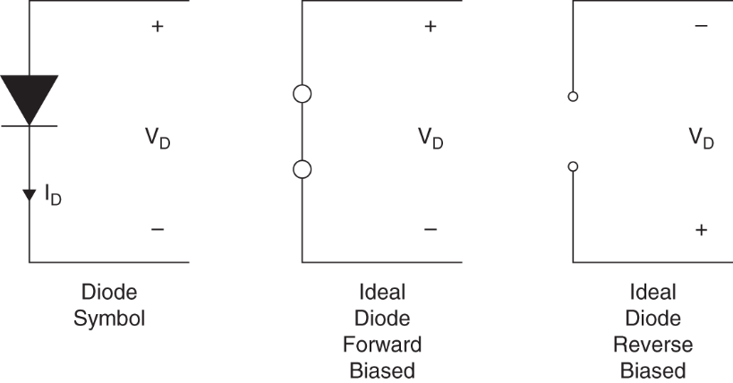
How a p-n junction diode works
The Ideal Diode Model
Actual diode and symbolic representation structure
Ideal diode and circuit models

Slide 10
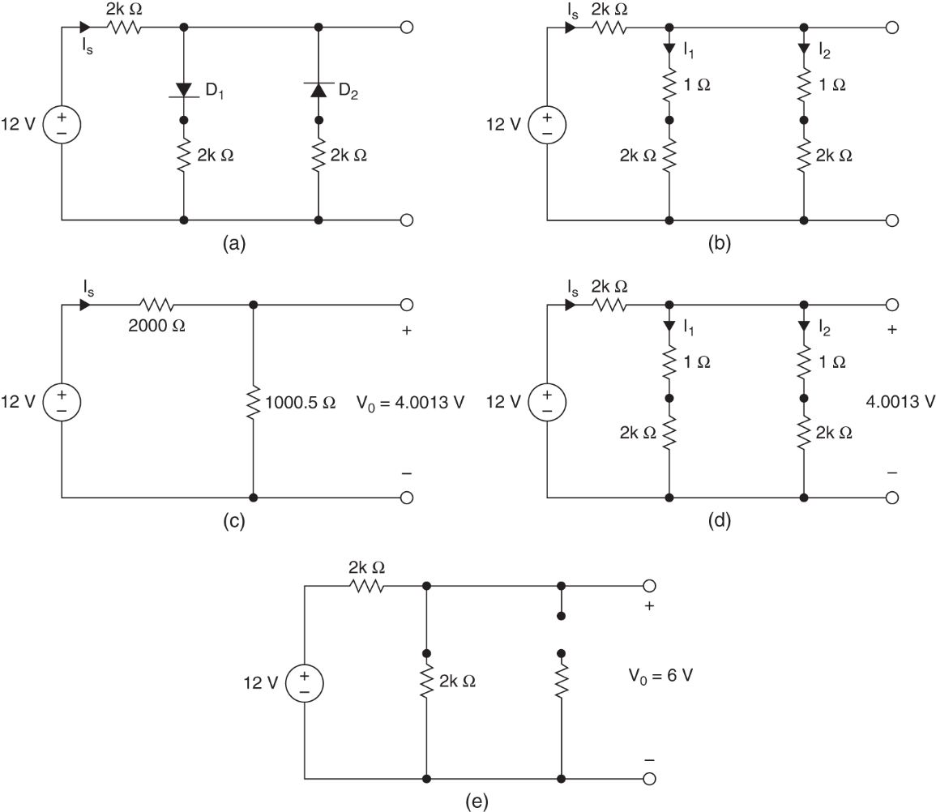
How a p-n junction diode works
Example 9.1

Slide 11
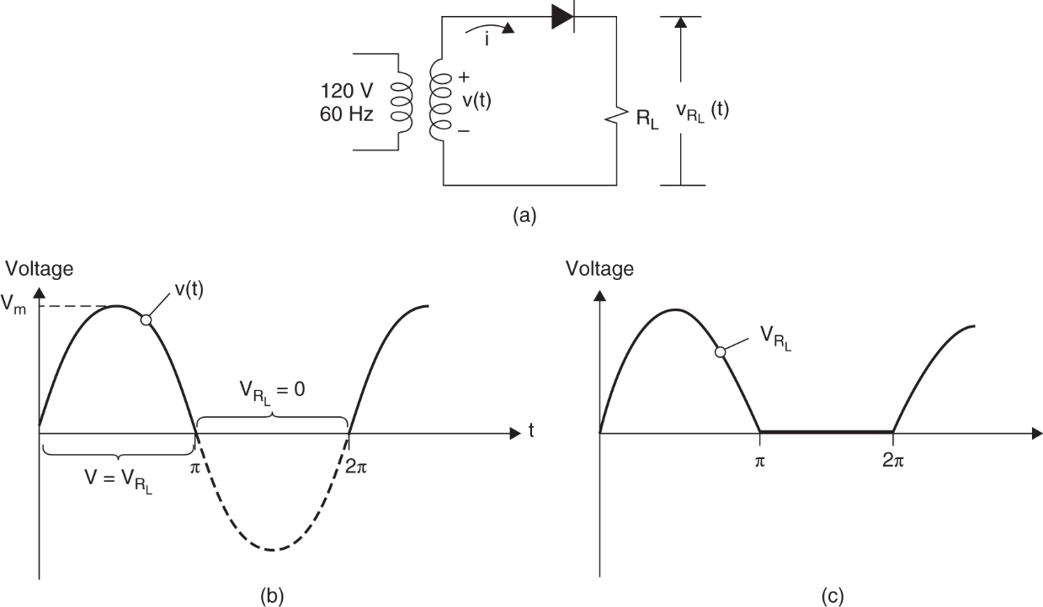
Rectifier circuits and power supplies
Half-wave rectifier circuits

Slide 12
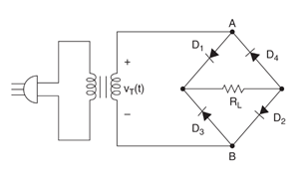
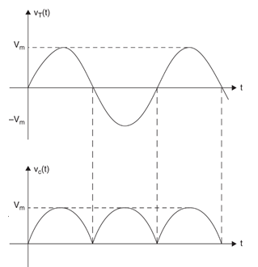
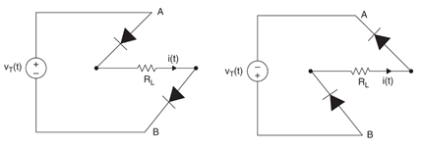

Rectifier circuits and power supplies
Full-wave bridge rectifier circuits
${ v}_{T}\left(t\right)=V_{m}sin(ωt)$

Slide 13
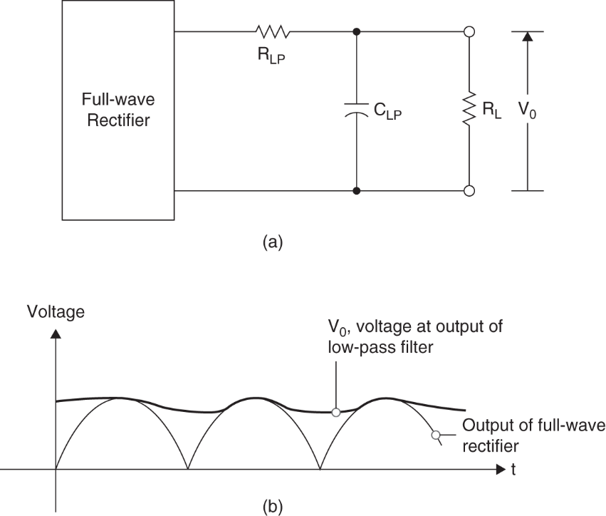
Power Supply Circuits
Power supply circuits
Filter : produce smooth dc from ac input
Ripple : small variation in voltage from filter output

Slide 14
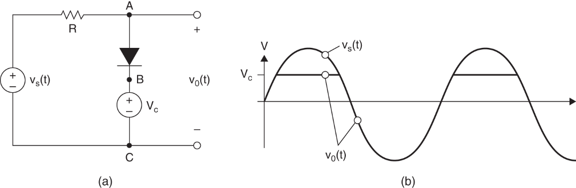
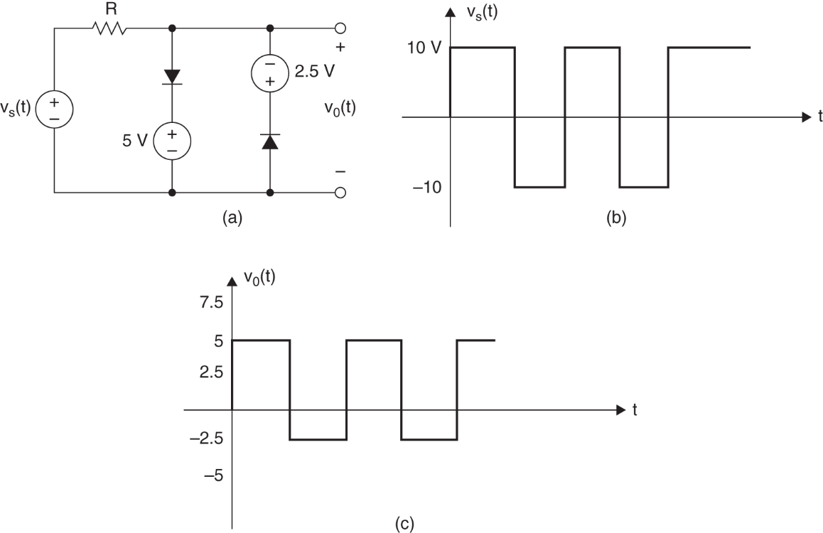
Clipper
Clipper
Example 9.4

Slide 15
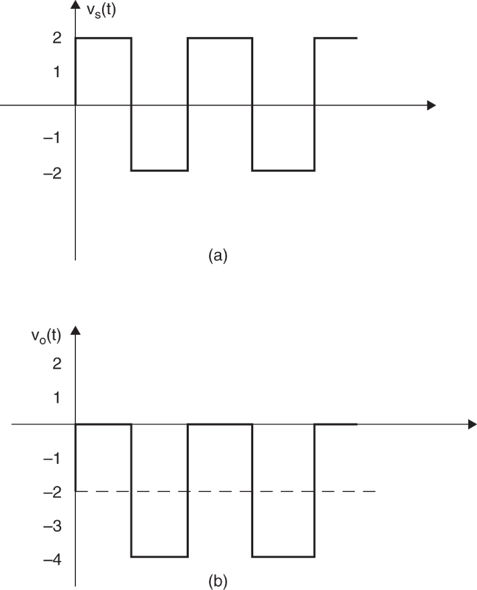
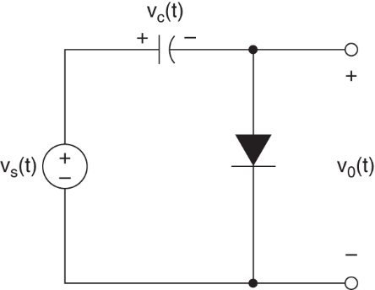

Clamper
Clamper
Example 9.5 $v_{o}\left(t\right)=v_{S}\left(t\right)−2$

Slide 16
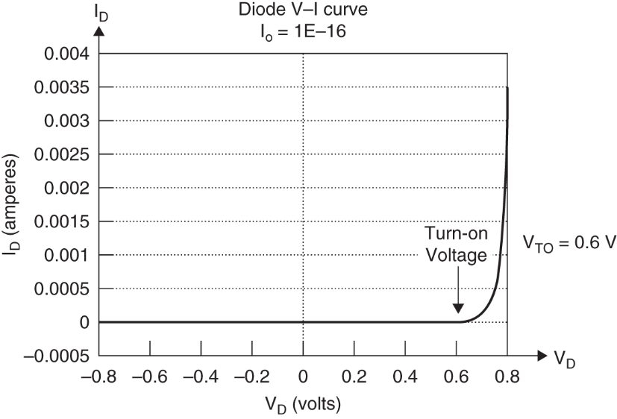
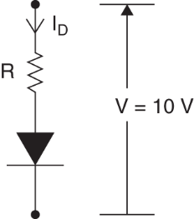
Real silicon Diode
Diode Equation and Model
Diode equation I_{D} : diode current I_{o} : reverse saturation current q : electronic charge V_{D} : voltage across the diode k: Boltzmann’s constant T: temperature
V-I curve with equation and series resistance

Slide 17
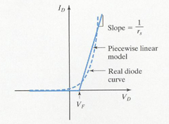
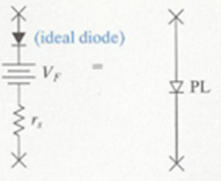
Real silicon Diode
The Piecewise Linear Diode Model
Turn-off voltage V_{F} 1 μA as the threshold of conduction, for silicon V_{F}=0.7V
V-I curve for piecewise linear model and symbol

Slide 18
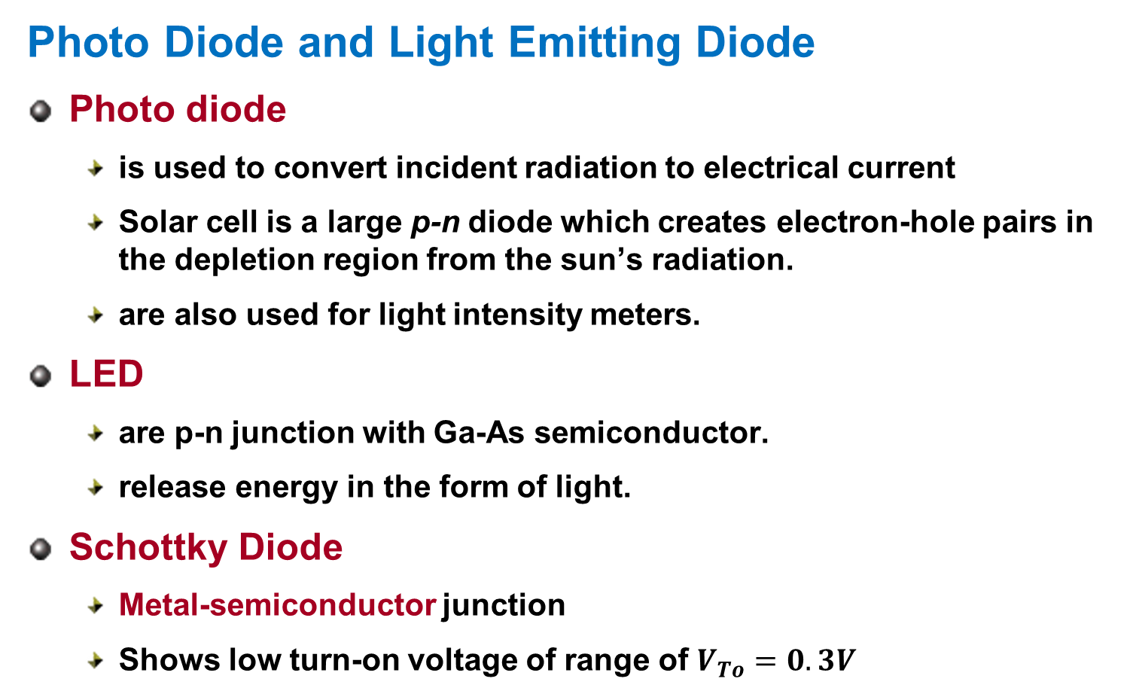
Photo Diode, LED, and Schottky Diode
Photo Diode and Light Emitting Diode
Photo diode
is used to convert incident radiation to electrical current
Solar cell is a large p-n diode which creates electron-hole pairs in the depletion region from the sun’s radiation.
are also used for light intensity meters.
LED
are p-n junction with Ga-As semiconductor.
release energy in the form of light.
Schottky Diode
Metal-semiconductor junction
Shows low turn-on voltage of range of $V_{To}=0.3V$

Slide 19
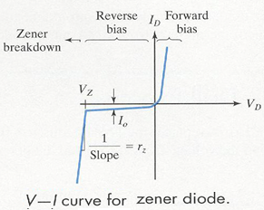
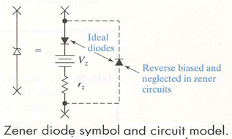
The Zener or Avalanche Diode
The Zener or Avalanche Diode
Breakdown
if reverse voltage increase high, a diode conducts a large current in the reverse direction.
the reverse current remains extremely small until the reverse bias voltage reaches breakdown voltage, called avalanche or zener breakdown voltage, V_{z}.

Slide 20
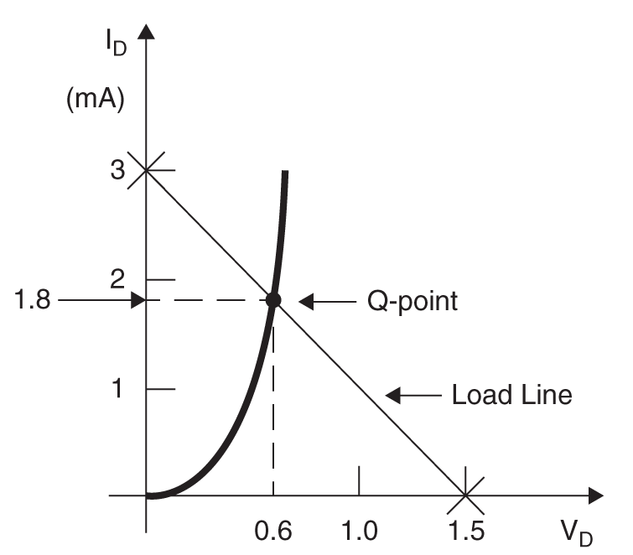
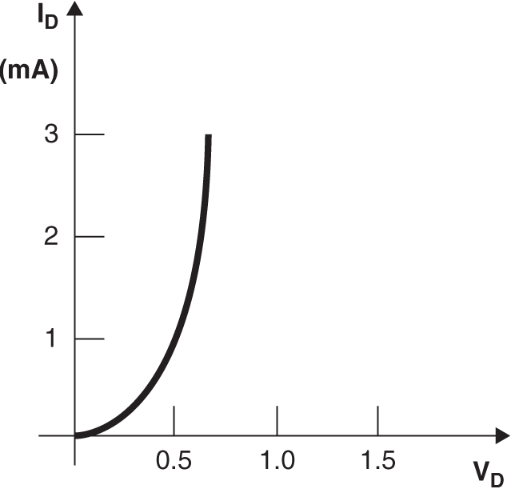
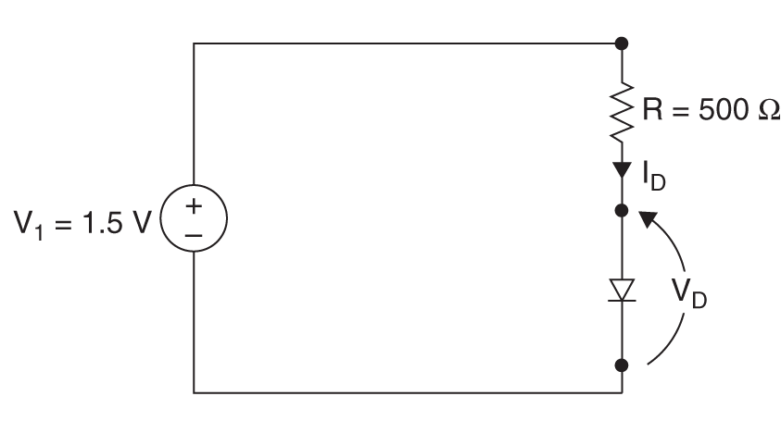

Load Lines and Graphical Solutions
Load Lines and Graphical Solutions
current I_{D}
by diode equation
loop equation
${∴ V}_{D}=0.6 V, I_{D}=1.8 mA$

Slide 21
Homework
Homework
Read Text Chapter 10.
Prepare Presentation

